Slide 1
Having Fun with T-SQL
Md. Khairul Alam MCTS, MCPD, CSM
Software Engineer, AML
DataSoft Systems Bangladesh Limited

Slide 2
SQL
SQL (Structured Query Language) is the query language used for communicating with data held in a relational database. It’s used as the standard language across all relational database management systems. However, each database management system has its own extensions thus the syntax and some functionalities might be different.
SQL was developed by IBM in the early 1970s under the name SEQUEL. Then due to some level trademark issues, it’s renamed to SQL, though a lot of people still call it sequel today.

Slide 3
T-SQL vs PL/SQL vs PL/pgSQL
TSQL, or T-SQL, shorts for Transaction-SQL, is an enhanced version of SQL which has with some extensions built on top of it. TSQL was originally developed by Sybase & now is owned by Microsoft.
TSQL adds some advanced features to SQL to make it more powerful such as declared variables, transaction control, error and exception handling, string operations, date and time processing.
These additions make T-SQL comply with the Turing completeness test, a test that determines the universality of a computing language. SQL is not Turing complete and is very limited in the scope of what it can do.

Slide 4
T-SQL vs PL/SQL vs PL/pgSQL
PL/SQL or Procedural Language/SQL is another extended form of SQL which is used by Oracle for their database.
The main difference between the TSQL and PL/SQL is the way they handle variables, stored procedures, and built-in functions. TSQL is also considered easier and simpler to understand while PL/SQL seems to be more complicated

Slide 5
T-SQL vs PL/SQL vs PL/pgSQL
PL/PgSQL is a PostgreSQL-specific procedural language based on SQL. Similar to TSQL and PL/SQL, it adds some advanced features to SQL such as loops, variables, error and exception handling, etc.
PL/pgSQL functions are considered as the better replacement for SQL functions in saving the client/server communication cost, this can result in a considerable performance increase

Slide 6
T-SQL Commands
Data Definition Language (DDL) statements
Data Management Language (DML) statements
Query statements
Flow of control statements
Assignment statements
Transaction statements
Procedure statements
Other statements

Slide 7
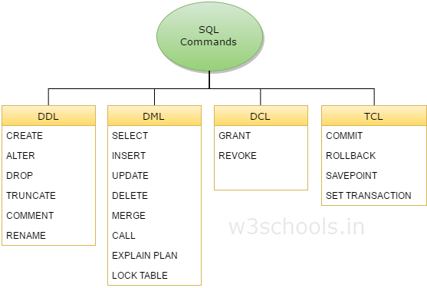
T-SQL Commands

Slide 8
T-SQL Features
Variables
Flow control
Basic CRUD
Changes to DELETE and UPDATE statements
BULK INSERT
TRY CATCH
Transaction Property(ACID)
Temp Table
Local vs Global

Slide 9
T-SQL Features
Table Variable
Table Type
User Defined Data Type
CTE
Cursor
Window Function
ROW_NUMBER, RANK, DENSE_RANK
Order by
Partition By
Over
Group By

Slide 10
T-SQL Features
View
Function
Store Procedure
Pivot Unpivot
Dynamic SQL

Slide 11
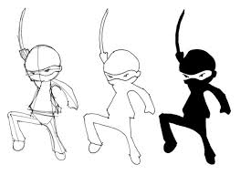
DDL & DML Hands on with T-SQL Features
Become Novice To Ninja

Slide 12
Tips and Tricks
Mastering T-SQL
Export Import Database

Slide 13
View
A VIEW, in essence, is a virtual table that does not physically exist in SQL Server. Rather, it is created by a query joining one or more tables.
CREATE VIEW [schema_name.]view_name AS
[ WITH { ENCRYPTION | SCHEMABINDING | VIEW_METADATA }
SELECT expressions
FROM tables
[WHERE conditions];

Slide 14
Q & A
Q & A

